Slide 1
2 D Transformations
More on 2D Transformations
Coordinate Transformations
Composite Transformations
Numerical Problems on 2D Transformations

Slide 2
2D Composite Transformations
We can setup a sequence of transformations as a composite transformation matrix by calculating the product of the individual transformations
P’=M₂·M₁·P
=M·P

Slide 3
2D Composite Transformations
Composite 2D Translations
If two successive translation are applied to a point P, then the final transformed location P' is calculated as

Slide 4
2D Composite Transformations
Composite 2D Rotations

Slide 5
2D Composite Transformations
Composite 2D Scaling

Slide 6
2D Composite Transformations
Don’t forget:
Successive translations are additive
Successive scalings are multiplicative
For example: If we triple the size of an object twice, the final size is nine (9) times the original
9 times?

Slide 7
General Pivot Point Rotation

Slide 8
2D Composite Transformations
General 2D Pivot-Point Rotation

Slide 9
General Fixed Point Scaling
Steps:
Translate the object so that the fixed point coincides with the coordinate origin.
Scale the object about the origin.
Translate the object so that the pivot point is returned to its original position.

Slide 10
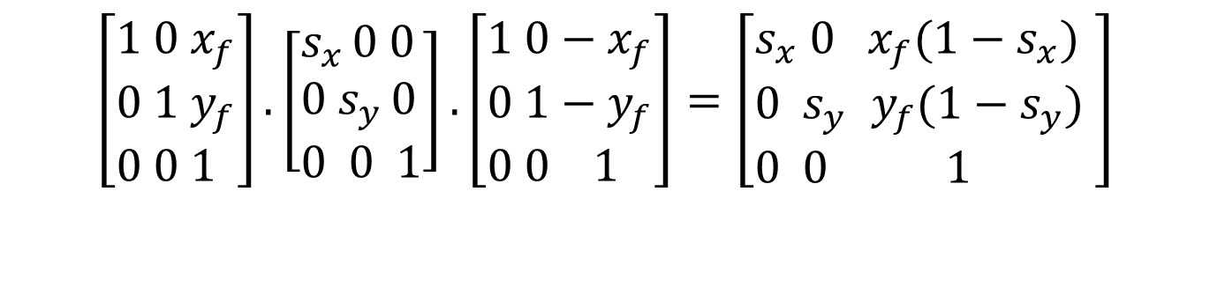
General Fixed Point Scaling
General 2D Fixed-Point Scaling:
$$\left[\begin{aligned}&1 0{ x}_{f} \\ &0 1 y_{f} \\ &0 0 1\end{aligned}\right].\left[\begin{aligned}&s_{x }0 0 \\ &0{ s}_{y }0 \\ &0 0 1\end{aligned}\right].\left[\begin{aligned}&1 0−x_{f} \\ &0 1−y_{f} \\ &0 0 1\end{aligned}\right]=\left[\begin{aligned}&s_{x} 0{ x}_{f}(1−s_{x}) \\ &0{ s}_{y }y_{f}(1−s_{y}) \\ &0 0 1\end{aligned}\right]$$
$$T(x_{f},y_{f})⋅S(s_{x},s_{y})⋅T(−x_{f},−y_{f})=S(x_{f},y_{f},s_{x},s_{y})$$

Slide 11
2D Composite Transformations
Matrix Concatenation Properties:
Matrix multiplication is associative !
M₃· M₂· M₁= (M₃· M₂ ) · M₁ = M₃· ( M₂ · M₁ )
A composite matrix can be created by multiplicating left-to-right (premultiplication) or right-to-left (postmultiplication)
Matrix multiplication is not commutative !
M₂ · M₁ ≠ M₁ · M₂

Slide 12
2D Composite Transformations
Matrix Concatenation Properties:
But:
Two successive rotations
Two successive translations
Two successive scalings
are commutative!

Slide 13
Transformation Between Coordinate Systems
Individual objects may be defined in their local cartesian reference system.
The local coordinates must be transformed to position the objects within the scene coordinate system.

Slide 14
Transformation Between Coordinate Systems
Steps for coordinate transformation
Translate so that the origin (x₀, y₀ ) of the x′-y′ system is moved to the origin of the x-y system.
Rotate the x′ axis on to the axis x.

Slide 15
Transformation Between Coordinate Systems (cont.)
y
x′
y'
y₀
θ
0
x₀
x

Slide 16
Transformation Between Coordinate Systems (cont.)
y
y₀
x′
y′
θ
0
x₀
x

Slide 17
Transformation Between Coordinate Systems (cont.)
y
y₀
y′
0
x′
x₀
x

Slide 18
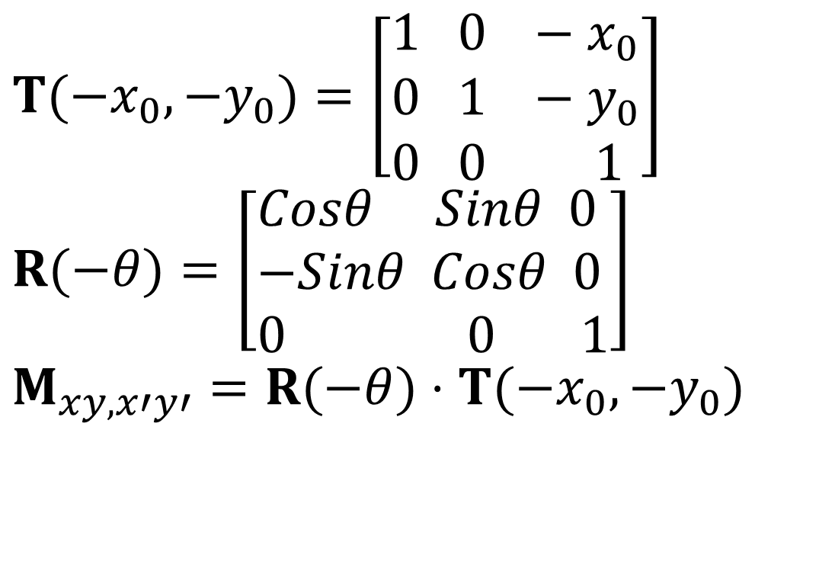
Transformation Between Coordinate Systems
$$T(−x_{0},−y_{0})=\left[\begin{aligned}&1 0 −x_{0} \\ &0 1 −y_{0} \\ &0 0 1\end{aligned}\right] \\ R(−θ)=\left[\begin{aligned}&Cosθ Sinθ 0 \\ &−Sinθ Cosθ 0 \\ &0 0 1\end{aligned}\right] \\ M_{xy,x′y′}=R(−θ)⋅T(−x_{0},−y_{0})$$

Slide 19
OpenGL Geometric Transformation Functions
A separate function is available for each of the basic geometric transformations
AND
All transformations are specified in three dimensions
Why?
Answer: Remember; OpenGL was developed as 3D library
But how to perform 2D transformations?
Answer: Set z = 0

Slide 20
Basic OpenGL Geometric Transformations
Translation
glTranslate* (tx, ty, tz);
* is either f or d
tx, ty and tz are any real number
For 2D, set tz=0.0
Rotation
glRotate* (theta, vx, vy, vz);
* is either f or d
theta is rotation angle in degrees (internally converted to radian)
Vector v=(vx, vy, vz) defines the orientation for a rotation axis that passes through the coordinate origin
For 2D, set vz=1.0 and vx=vy=0.0

Slide 21
OpenGL Matrix Operations
glMatrixMode(.);
Projection Mode: Determines how the scene is projected onto the screen
Modelview Mode: Used for storing and combining geometric transformations
Texture Mode: Used for mapping texture patterns to surfaces
Color Mode: Used to convert from one color mode to another

Slide 22
OpenGL Matrix Operations
Modelview matrix, used to store and combine geometric transformations
glMatrixMode(GL_MODELVIEW);
A call to a transformation routine generates a matrix that is multiplied by the current matrix
To assign the identity matrix to the current matrix
glLoadIdentity();

Slide 23
OpenGL Matrix Operations (cont.)
Alternatively:
glLoadMatrix* (elements16);
To assign other values to the elements of the current matrix
In column-major order:
First four elements in first column
Second four elements in second column
Third four elements in third column
Fourth four elements in fourth column

Slide 24
OpenGL Matrix Operations (cont.)
Concatenating a specified matrix with current matrix:
glMultMatrix* (otherElements16);
Current matrix is postmultiplied (right-to-left) by the specified matrix
Warning:
Matrix notation m_{jk} means:
In OpenGL: j → column, k → row
In mathematics: j → row, k → column

Slide 25
OpenGL Matrix Stacks
OpenGL maintains a matrix stack for transformations
Initially the modelview stack contains only the identity matrix

Slide 26
OpenGL Transformation Routines
For example, assume we want to do in the following order:
translate by +2, -3, +4,
rotate by 45⁰ around axis formed between origin and 1, 1, 1
scale with respect to the origin by 2 in each direction.
Our code would be
glMatrixMode(GL_MODELVIEW);
glLoadIdentity(); //start with identity
glScalef(2.0,2.0,2.0); //Note: Start with the LAST operation
glRotatef(45.0,1.0,1.0,1.0);
glTranslatef(2.0,-3.0, 4.0); //End with the FIRST operation

Slide 27
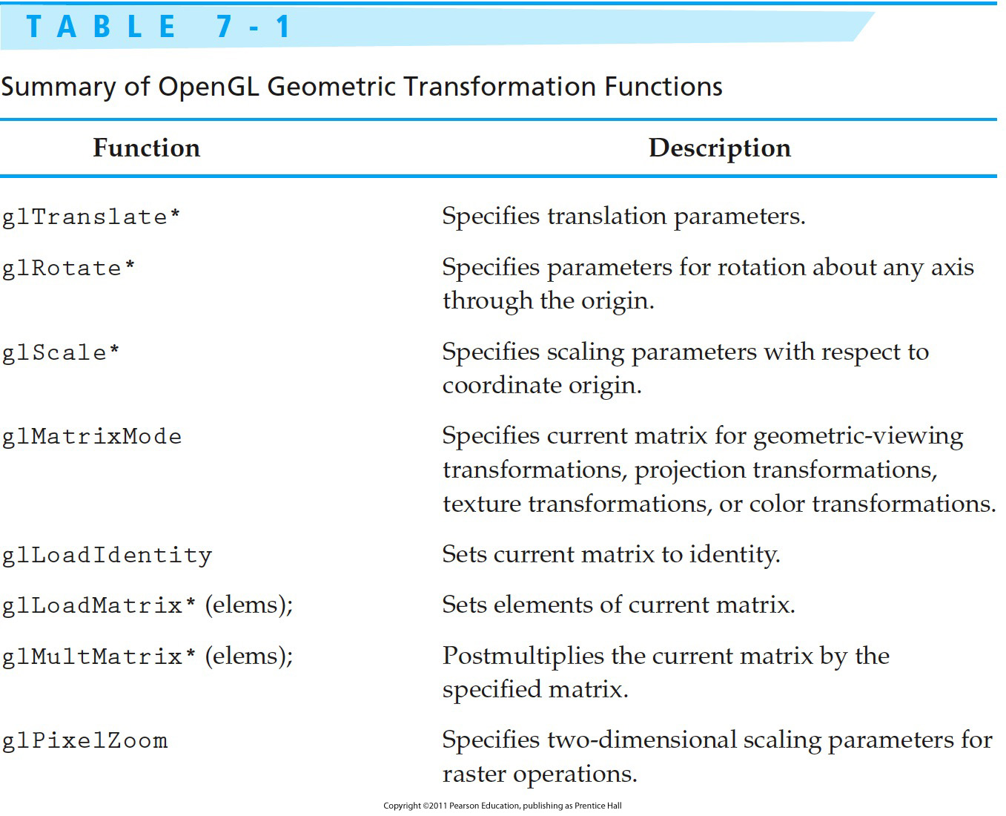
OpenGL Transformation Functions

Slide 28
Numerical Problems
Prove that
Solution:

Slide 29
.
.
LHS=RHS, so components of matrices are required to be same. i.e.

Slide 30
.
.
From Equation (2)
Hence proved

Slide 31
Numerical Problems Contd.
Find the matrix that represents rotation of an object by 30 degree about origin
What are the new coordinates of the point
Solution:

Slide 32
.
.
So, the new coordinates can be found by multiplying
So new coordinate of point P is

Slide 33
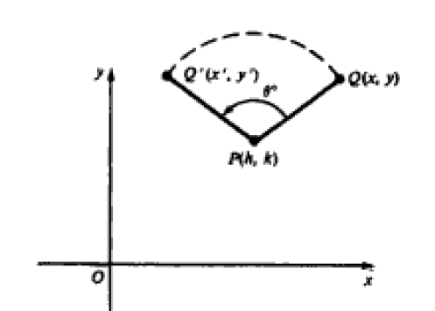
Numerical Problems Contd.
Describe the transformation that rotates an object point Q(x,y), about a fixed centre of rotation P(h,k). Write in form of matrix.
Solution: we determine rotation
In three steps:
1. Translate so that center of rotation P is at origin
2 Perform a rotation of theta degree about origin
3. Translate P back to (h,k)

Slide 34
.
Using v=hI+kJ as the translation vector , we build by composition of transformation

Slide 35
Numerical Problems Contd.
Perform a 45 degree rotation of triangle A(0,0), B(1,1), C(5,2)
(a) about origin
(b) about P(-1,-1)
Solution: we represent the triangle by a matrix formed from the homogenous coordinates of vertices

Slide 36
.

Slide 37
.(b) The rotation matrix is given by

Slide 38
.

Slide 39
Numerical Problems Contd.
Magnify the triangle with vertices A(0,0), B(1,1) and C(5,2) to twice its size while keeping C(5,2) fixed.
Solution:

Slide 40
.

Slide 41
Numerical Problems Contd.
Illustrate the effect of shearing transformation on the square with vertices A(0,0), B(1,0),C(1,1) and D(0,1) when Shx=2 and Shy=3 .
Solution:

Slide 42
.
.

Slide 43
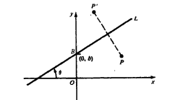
Numerical Problems Contd.
Describe the transformation ML which reflects an object about a line L.
Find the form of the matrix for a reflection about a line L with slop m and y intercept (0,b)
Solution:

Slide 44
.
Let line L in previous figure have y intercept(0,b) and an angle of inclination theta degree (with respect to x axis)
We reduce the description to known transformations, we need following steps:
1. Translate the intersection point B to origin
2. Rotate by –theta degree so that L align with x axis’
3. Mirror reflection about x axis
4. Rotate back by theta degree
5. Translate back B to (0,b)
In transformation notation we have

Slide 45
.
.
Now put these values in ML

Slide 46
Numerical Problems Contd.
Reflect the diamond shaped polygon whose vertices are A(-1,0), B(0,-2), C(1,0) and D(0,2) about
(a) the horizontal line y=2
(b) the vertical line x=2
(c) the line y=x+2
Solution: we represent the vertices of polygon by homogeneous coordinate matrix

Slide 47
.
.

Slide 48
.
.

Slide 49
.
.

